Slide 1

Global Implementation Update
Erwin Lassooij
PBN Programme Manager
ICAO HQ, Montreal, Canada

Slide 2


Outline
Introduction/Background
Global and APAC Implementation
PBN and the ASBUs
ICAO Initiatives
Summary

Slide 3

Why PBN?
REDUCES
INFRASTRUCTURE
INCREASES AIRSPACE CAPACITY
IMPROVES OPERATIONAL EFFICIENCY
PBN BENEFITS
REDUCES
ENVIRONMENTAL
IMPACT
IMPROVES
SAFETY

Slide 4




Major input to the PBN Program

Slide 5

Key PBN Related Outcomes
States urged to comply with A37-11 targets
States urged to continue to support ICAO PBN initiatives with resources
ICAO to clarify regulatory oversight requirements for PBN implementation (HLSC 2015)
ICAO to develop additional PBN provisions aligned with the Aviation System Block Upgrades (ASBUs), GANP and GASP
ICAO to provide implementation support
  PBN training and education
  Implementation projects and tools
  Flight Procedures Programme (FPP)

Slide 6

A37-11 PBN Global Targets
States complete a PBN Implementation Plan to achieve:
  Approach procedures with vertical guidance (APV (Baro-VNAV) including LNAV-only minima for all instrument runway ends by 2016:
    30% by 2010, 70% by 2014
  Straight-in LNAV only procedures as an exception to the above where there is:
    no local altimeter setting; and
    no aircraft equipped for APV with max certified mass of 5700kg or more

Slide 7

So where are we today?

Slide 8
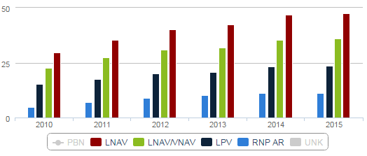






PBN IMPLEMENTATION TRENDS
% of PBN Approaches by type for the world
(rate refers to the total number of instrument runways)
1606
1214
798
385
1631
1239
809
385
This data is based on the International Aerodromes as listed in the Regional Air Navigation Plans
World States include the total number of ICAO Member States
May 2015

Slide 9
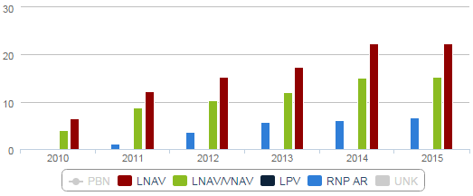







PBN IMPLEMENTATION TRENDS
% of PBN Approaches by type for APAC
(rate refers to the total number of instrument runways)
106
71
29
106
72
31
This data is based on the International Aerodromes as listed in the Regional Air Navigation Plans
APAC States include the total number of ICAO Member States for the Asia-Pacific Region

Slide 10



PBN IMPLEMENTATION TRENDS
% of PBN SID/STAR for the world
(rate refers to the total number of instrument runways)
1168
1038
1197
1070
This data is based on the International Aerodromes as listed in the Regional Air Navigation Plans
World States include the total number of ICAO Member States

Slide 11



PBN IMPLEMENTATION TRENDS
% of PBN SID/STAR for APAC
(rate refers to the total number of instrument runways)
221
218
227
222
2010 2011 2012 2013 2014 Apr.2015
This data is based on the International Aerodromes as listed in the Regional Air Navigation Plans
APAC States include the total number of ICAO Member States for the Asia-Pacific Region

Slide 12
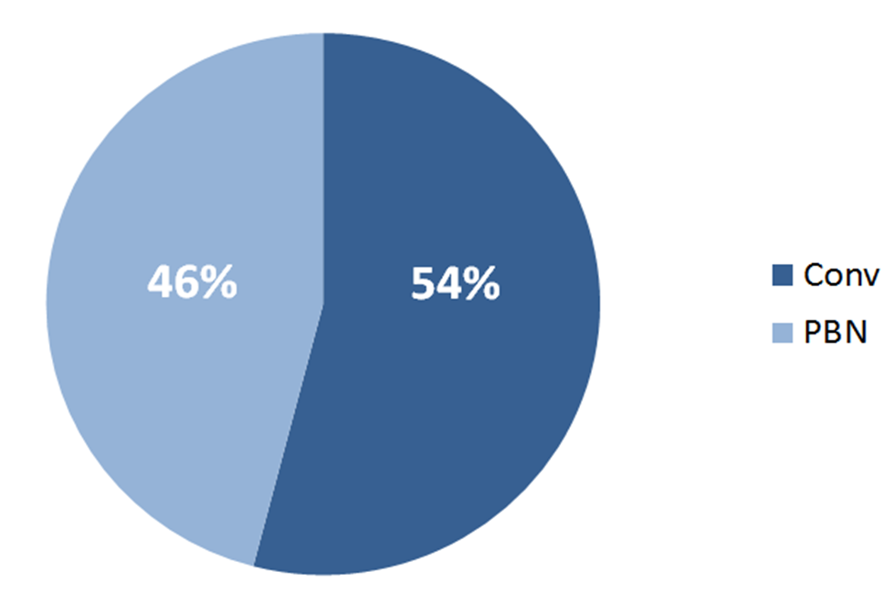


PBN Versus Conventional Routes

Slide 13
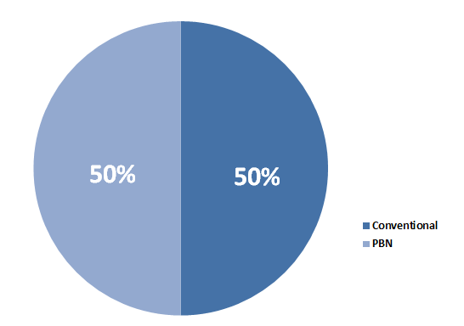

PBN Versus Conventional Routes

Slide 14
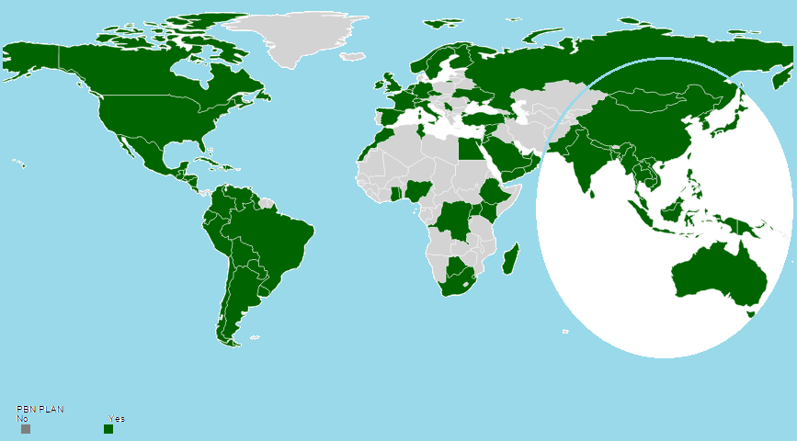
Implementation Plans
Afghanistan
Bhutan
Brunei Darussalam
China (Macau)
Cook Islands
Kiribati
Marshall Islands
Micronesia (Federated States of)
Naura
Palua
Samoa
Solomon Islands
Timor-Leste
Vanuata

Slide 15
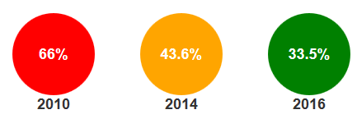
Percentage of States meeting the A37-11 Resolution Targets
2010
2014
2016

Slide 16
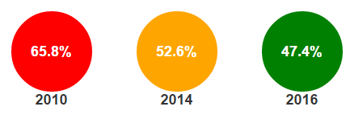
Percentage of APAC States
meeting the A37-11 Resolution Targets
2010
2014
2016
The good news: Half of the class is doing really well
The bad news: The other half needs serious education/encouragement

Slide 17
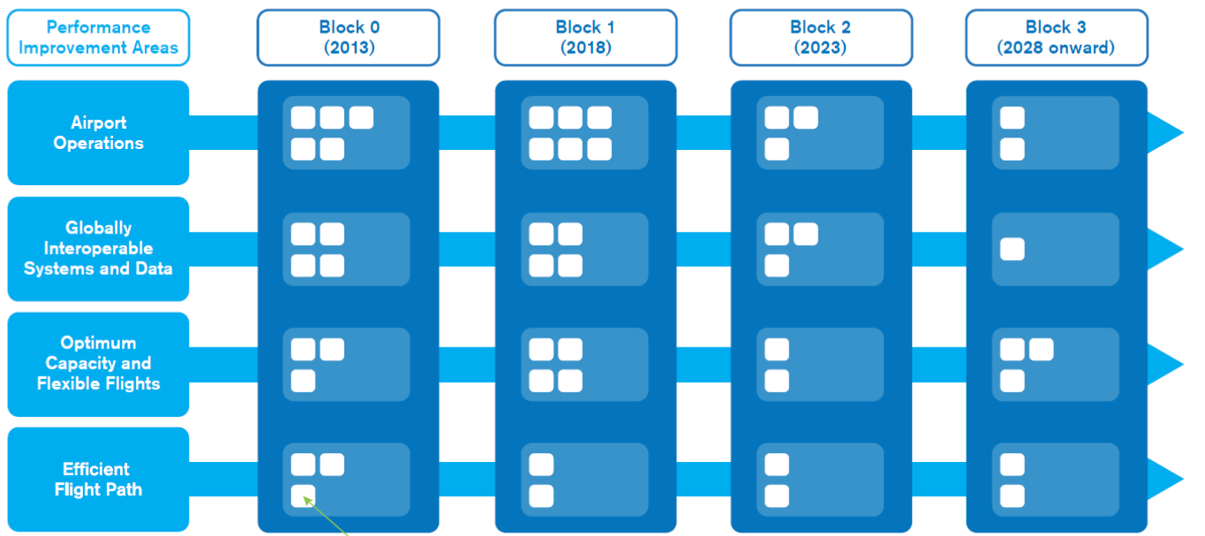
PBN and the ASBUs
Objectives and Priorities
PRIORITIES
Performance Based Navigation (PBN)
Continuous Descent and Climb Operations (CDO/CCO)
Collaborative Decision-Making (CDM & A-CDM) & ATFM

Slide 18

PBN and the ASBU Modules
ASBU MODULES
Operational Improvement
APTA – Airport Accessibility
Improves the efficiency of terminal control area (TMA) operations
ACDM – Airport CDM
SURF – Surface Operations
AMET – Advanced Meteorological Info.
FRTO – Free Routing
NOPS – Network Operations
ASEP – Airborne Separation
CCO – Continuous Climb Operations
CDO – Continuous Descent Operations
TBO – Trajectory Based Operations

Slide 19

Extending Modules to iKits
ASBU MODULES
Operational Improvement
APTA – Airport Accessibility
Improves the efficiency of terminal control area (TMA) operations
ACDM – Airport CDM
SURF – Surface Operations
AMET – Advanced Meteorological Info.
FRTO – Free Routing
NOPS – Network Operations
ASEP – Airborne Separation
CCO – Continuous Climb Operations
CDO – Continuous Descent Operations
TBO – Trajectory Based Operations

Slide 20
PBN Programme Office
Officially established 1st October 2014
Responsible for the global coordination of the PBN Programme
  Act as ICAO’s PBN focal point
  Develop the PBN Standards and other required guidance material
  Coordinate with ICAO Regions to ensure consistent and expeditious implementation
  Monitor the global implementation of PBN
  Develop PBN Products and Services

Slide 21
PBN PMO ORGANIZATION
PBN PM
Erwin Lassooij
PBN Secretary
Nadia Soltani
PBN TO
Ian Knowles
PBN / AOI TO
Roberta Luccioli
PBN Consultant
Jeff MacDonald
PBN Business Consultant
Claudia Mariscal
Programme Planning and oversight
FPP Oversight/Coordination
Budget Management
Section/agency liaison
Administration
Record/File Management
FLOPSP Coord
PLT TRG CBT
PBNSG
PANS-OPS Vol I
PBN Ops Approval
IFPP Coord
PANS-OPS Vol II
Web-sites
PBN Data
PBN Endorsements
Business Plan support
Reports
TRG (General)
SME Input
PBN Business Plan
PBN Marketing

Slide 22

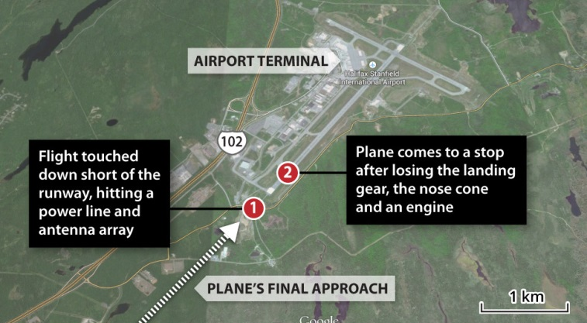
Implementation Concerns
Runway excursions
CFIT
Unstable approaches
Lack of procedures with vertical guidance (APV)
Lack of State PBN Implementation Plans
Non-compliance with meeting A37-11 targets
Air Operators not PBN equipped
Delays in granting PBN Ops Approvals

Slide 23

What has ICAO done to help States with implementation? . . .

Slide 24

Coordination with RO’s
PBN Focal points
PBN TF’s, ICGs – awareness and coordination among States
Implementation Projects
Go-Teams
Symposia

Slide 25

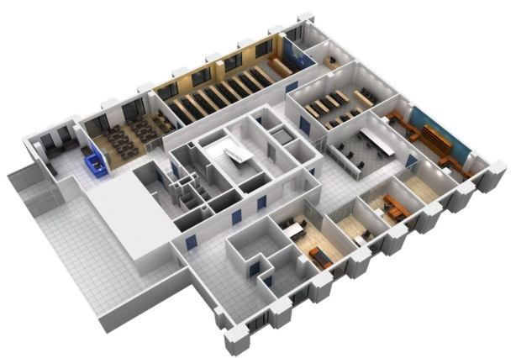

Flight Procedures Programme (FPP)
Beijing, China
  Upgraded to Regional Sub-Office
Dakar, Senegal
  FPP Office established 2014 (covers all African States)
MID Region?

Slide 26
ICAO/IATA PBN GO Teams
Expert Teams Visits to address specific implementation issues
  Phase I (PBN Requirements Assessment) completed
  Phase II (Airspace Design and Operations Approvals) will be completed in early July (Last visit to China)
Future ICAO Visits will be specific to address Region and/or State requirements for PBN Implementation
  On request basis
Focus/Services provided will be:
  PBN Assessments / Gap Analysis
  PBN Plan Development
  Training
  Implementation Assistance
Completed Global Visits
Phase (I and II)
Thailand (2) UAE (2)
Mexico Kenya
Germany India
Ecuador Russia
South Africa USA (CAR/SAM)

Slide 27
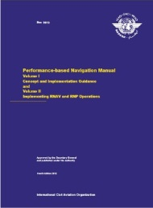
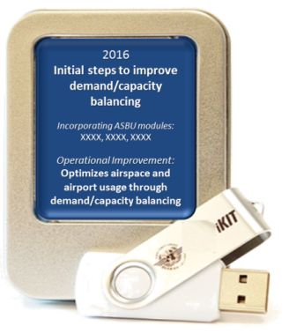
PBN Documentation Framework
PANS Ops Volume I
PANS Ops Volume II
PBN Manual (Doc 9613) 4th Edition
RNP AR Procedure Design Manual (Doc 9905)
PBN Ops Approval Manual (Doc 9997)
Manual on PBN Use in Airspace Design (Doc 9992)
CDO Manual (Doc 9931)
CCO Manual (Doc 9993)
GNSS Manual (Doc 9849)
Procedure QA Manual (Vol 1 to Vol 6)
(Doc 9906)
4th Edition
Notes:
In 2008 the PBN manual was published which provides the framework for PBN implementation:
Volume 1 of this manual describes the concepts, the processes to be followed and short descriptions of all required stakeholders
Volume 2 provides the navigation specifications which are the basis for operational requirements and ops approval for aircraft. These ops requirements are also the basis for the navigation applications such as flight procedures and separation and route spacing requirements. This linkage is very important, because now we can make the airspace design fit the fleet capability and not the other way around.
Since the introduction of the PBN manual, the ICAO Annexes have been amended to support the PBN concept, procedures have been amended to support obstacle clearance and separation requirements and a host of new guidance in the form of new manuals.
The original PBN manual contained globally harmonized requirements that were based on specifications that already pre-existed on a national or Rgional level. [CLICK] Now, the latest is the new PBN manual which includes new navspecs, such as Advanced RNP, RNP 2, RNP 0.3 for helis and RF legs. For sure this will be discussed in more detail later in the sessions.

Slide 28
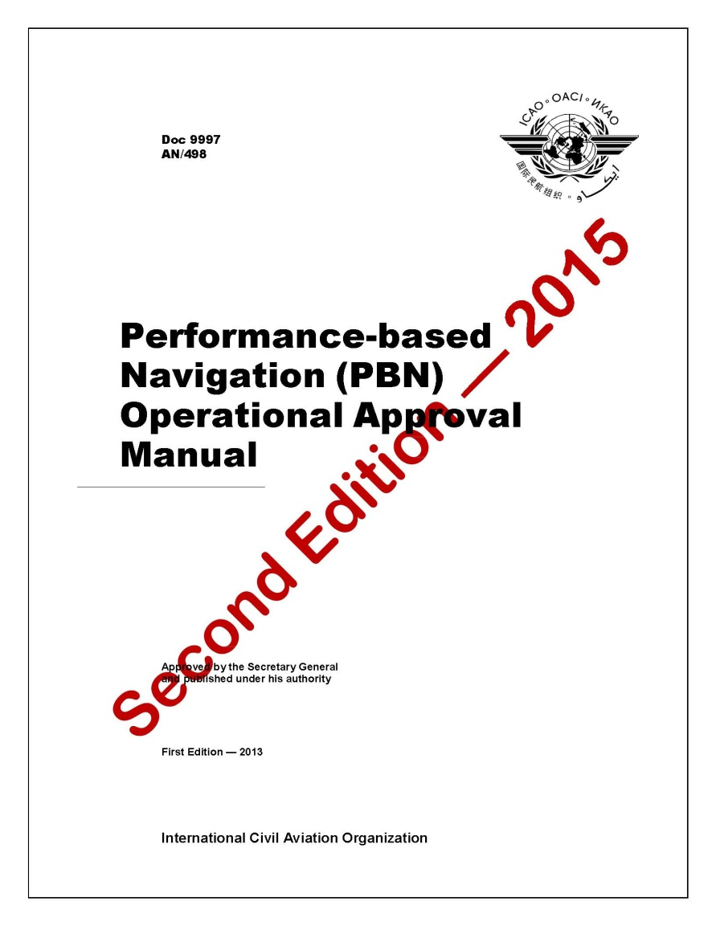
PBN Ops approval manual (now available)
New navspecs
  RNP 2
  Advanced RNP
  RNP 0.3
  RF requirements
Streamlined
Third edition (2016)
  Complex PBN
  AFM requirements

Slide 29

PBN Tailored Products and Services
PBN Start
PBN Training
PBN Publications and Bundles
PBN Symposia/Workshops
PBN Implementation Assistance
PBN Business Planning
PBN Financial Aid
Provided through ICAO HQ, Regional Offices, FPPs, ICAO Authorized Training Centers, On-line ICAO Store

Slide 30
PBN Training
Computer Based Training Courses (CBTs)
PBN Classroom Courses
PBN Overview
PBN Ops Approval
PBN Airspace Design
PBN for Pilots
PBN for ATCOs
(available late summer)
PBN Ops Approval
PBN Airspace Design
(available from ICAO HQ)
PD Courses
(available from ICAO HQ and FPP Offices)

Slide 31



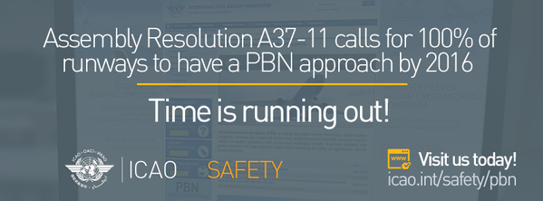




Raising PBN Awareness
#icaoPBN

Slide 32

Implementing Air Navigation’s #1 Priority
Performance-based Navigation (PBN)
Having difficulty implementing PBN and achieving the many safety and efficiency benefits?
ICAO can help tailor a solution for your needs. Contact us at:
www.icao.int/PBN

Slide 33

PBN Recognition – IFP Organizations
Endorsement/Recognition of Compliance of Instrument Procedure Design organizations
To assist States with PBN Implementation
Organizations recognized by ICAO (9):
  Airways New Zealand
  ASAP s.r.o. (Slovakia)
  Beijing Transafe Technology and Trade Company, Limited (China)
  CAAC Central-Southern Airport Design & Research Institute (China)
  China Academy of Civil Aviation Science and Technology (CAST)
  GE Aviation (USA)
  Hughes Aerospace (USA)
  Ingegneria Dei Sistemi S.p.A (Italy)
  Shanghai Eastern China Civil Aviation Procedure Design and Research Institute (SECAF)
Name of Organization
Notes:
Another example, to support implementation, we have now launched the endorsement programme, endorsing external organizations that have demonstrated to meet certain criteria, terms and conditions to develop instrument procedures. The benefits are two-fold; first it facilitates Regulators having difficulty to select proper consultants for the development of the procedures in their State and secondly it could be a tool for avoiding the need for multiple State endorsements, hence reducing costs.

Slide 34

Future PBN SARPs and guidance

Slide 35

PBNSG Main Tasks
Current PBNSG Work Program:
  Develop strategic plan for PBN concept (2016)
  Update the Ops Approval Manual (Doc 9997) (2016)
    Inclusion of Complex PBN
  Develop reversion strategy for GNSS outage (2017)
  Develop initial guidance for mixed mode operations (2017)
  Develop operational guidance on PBN procedures (2017)
  Investigate use of Multi-Constellation/Multi Frequency for GNSS (2017)
  Flight plan codes for all nav specs and options (2018)
  Implementation of RF legs and FRT’s (2020)
  Develop RNP AR Departure procedures (2020)

Slide 36
PBNSG Inter-panel Coordination
GBAS CAT II/III, charting/database Harmonization, Regulatory oversight,
Visual PBN procedures, PBN to XLS
Making PBN the norm in operations,
Visual guided Approaches using Area Navigation
GBAS CAT II/III, Galileo/Beidou terrestrial navaid strategy
CDO/CCO Phraseology
RNP1, RNP2, ARNP RNP APCH, RNP AR APCH separation standards
Parallel sep standards for GBAS/RNP
Reduced divergence departures
IFPP
FLTOPSP
Flight Operations
NSP
Navigation Systems
ATMOPSP
SASP
Flight Procedures
ATM procedures
Separation Standards
PBN SG

Slide 37
Flight Operations (FLTOPSP)
Making PBN the norm in operations rather than the exception
  Simplify the approval process (2016)
  Specific Approval only for ‘Complex PBN operation’ (2016)
  Update training provisions to include PBN (2018)
    (PANS TRAINING and Annex 6)

Slide 38
Flight Operations (FLTOPSP)
  Use of Area Navigation capability on conventional procedures (2018)
  Overlay procedures
  Use of Substitute and Alternate means of navigation
  Develop Visual Guided Approaches (2018)
  Concept of Operations to include use of Area Navigation capability

Slide 39
Flight procedures (IFPP)
  LP/Baro-VNAV (2018)
  RNP AR Departures (Revision of RNP AR Design Manual) (2018)
  Visual procedures using PBN (2018)
  GBAS CAT II/III (2018)
  GBAS Terminal Operations (2018)
  Fixed Radius Transitions (for enroute) - promulgation (2018)
  Helicopter PBN Operations (2018)
  Provision of Information for the Strategic Development of PBN (2018)
  PBN/IFP Regulatory Requirements (Annex 11)
    Guidance material on Safety Assessment (2018)
Notes:
The Multidisciplinary Meeting Regarding Global Tracking was attended by 207 participants from forty-four Member States and nineteen international organizations. Many of you participated.
In negotiations with IATA beforehand, IATA had agreed to initiate global tracking on a voluntary basis and, working under the framework of ICAO, to establish a Task Force to recommend the ways and means. With that agreement acknowledged, it set a foundation for the Special Meeting. The meeting then quickly reached consensus that aviation’s near-term priority was to track airline flights, no matter what their global location or destination. The meeting also established a framework for future efforts on this subject for the medium and long term.
The Appendix to C-WP/14177 contains the conclusions and recommendations agreed to by the meeting. Conclusions indicate the actions that “will” be undertaken to address the near-term needs for flight tracking. Recommendations indicate the actions that “should” be undertaken which require further consideration by the Council. I’d like now to give you a short progress report.

Slide 40
PBN Approach Chart Depiction
Interim Naming (until 30 Nov 2022) | Final Naming (from 1 Dec 2022)
RNAV _{(GNSS)} RWY 23 | RNP RWY 23
RNAV Z _{(GNSS)} RWY 23 | RNP Z RWY 23
RNAV _{(RNP)} RWY 23 | RNP RWY 23 (AR)
Procedures that are currently named RNAV and meet the RNP APCH NAV SPEC will be designated RNP
States may go directly from current naming to final convention
Refer to PANS-OPS Vol II and ICAO Circular 336 for more Information

Slide 41
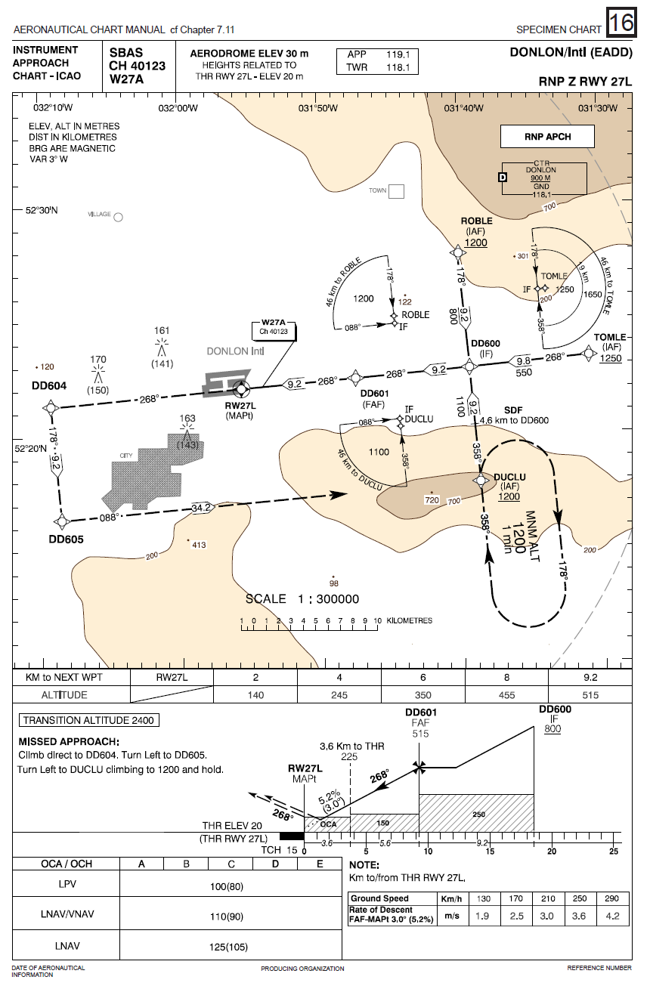
PBN Approach Chart Requirements Box
Navigation Specification | Optional Requirements
RNP APCH | RF required
RNP AR APCH | RF required RNP <0.3 Missed approach RNP <1
ADVANCED RNP | RNP <1 in initial and intermediate segment
RNP 0.3 | RF required
PBN requirements box includes NAV SPEC and optional requirements not in core NAV SPEC

Slide 42
Navigation Systems (NSP)
Fixes to existing GNSS SARPs as required (2016 onwards)
Development of terrestrial navaids strategy (including rationalization) (2016)
GBAS CAT II/III SARPs (2018)
Development of Galileo SARPs (2018)
Development of Beidou SARPs (2018)
Modernization of GPS/GLONASS SARPs (2018)
Multi-frequency, multi-constellation (MFMC) issues (2018)
Advanced RAIM (2018)

Slide 43
Separation Standards (SASP)
GBAS Landing System (GLS) for parallel rwy ops (2018)
  Procedures and guidance required
  Comparative assessment (ILS/MLS vs GLS and RNP) to derive GLS requirements
Reduced Divergence Departures – Separation Minimum for Equivalent Lateral Separation Operation (ELSO) (2018)
  Take advantage of PBN to provide more efficient operations in increasingly constrained airspace

Slide 44
Separation Standards (SASP)
Stabilized RNP approaches to parallel runways (2018)
  Take advantage of PBN capable aircraft
  Undertake new safety assessment
Oceanic/Continental Airspace LONG/LAT Separation Minima (2018)
  For RNP-2 and A-RNP
Application of PBN based lateral separation Minima to Special Use Airspace (SUA) (2018)
  Amendment proposals
  Review Circular 324

Slide 45
Separation Standards (SASP)
Airspace planning guidance for implementing PBN tracks (2018)
  Develop provisions to address establishing ATS routes for PBN equipped aircraft (mixed capability)
LAT/LONG Separation Guidance for Helicopter RNP 0.3 (Terminal and Enroute) operations (2018)
  Develop necessary provisions
  Consider feasibility of expanding application to F/W aircraft

Slide 46
ATM procedures (ATMOPSP)
SID/STAR phraseology (2016)
  Will facilitate use of CDO and CCO
PANS ATM provisions related to PBN closed path approaches (2018)
  For parallel runway operations
PBN approach clearance phraseology (2018)

Slide 47
Summary
PBN Implementation is Air Navigation’s #1 Priority
Global support for PBN Implementation by all stakeholders
PBN main enabler for many ASBU modules and ROIs
However, rate of implementation slow in some regions
  Need for regulatory oversight
  More Implementation guidance needed
  Products and Services are now available to assist States
Coordination and pro-active attitude is essential to effective implementation

Slide 48

Thank You!

